Slide 1
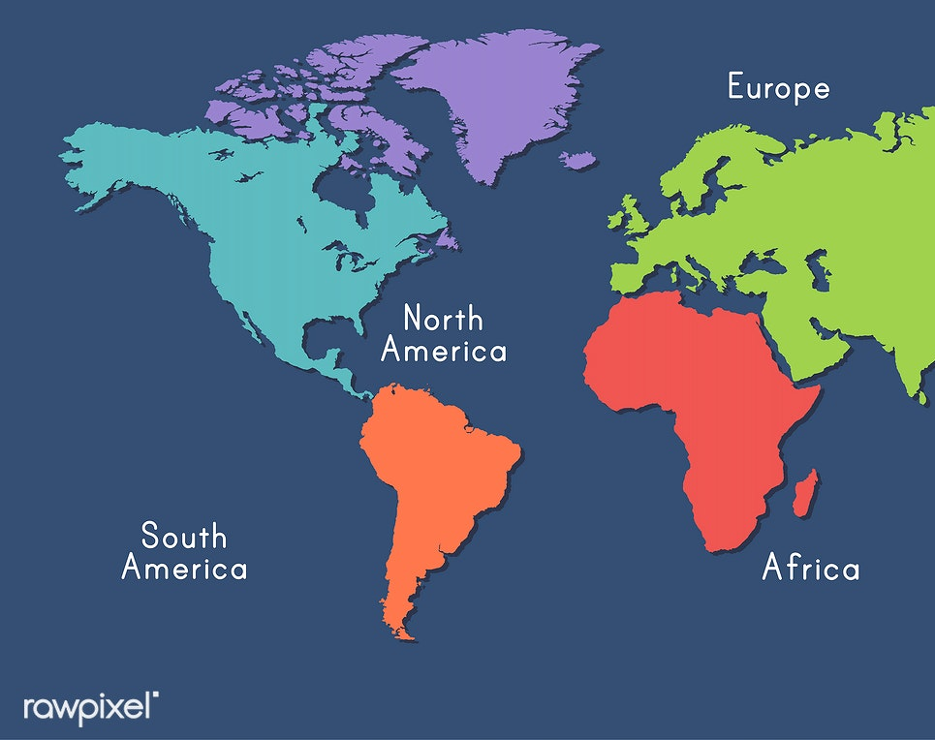
Discovering the determinants of economic growth

Slide 2

Agenda
Introduction of Project
The Dataset
Exploratory Data Analysis
Model Selection
Summary
Appendix

Slide 3
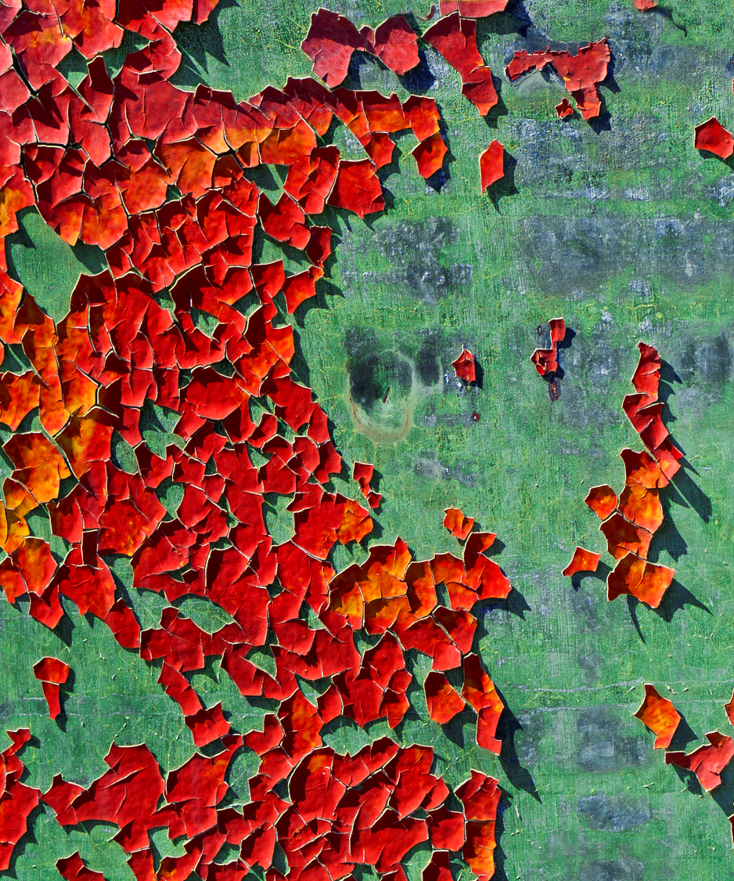
Introduction of Project
We found this dataset on Kaggle, our initial intention was to look for datasets re: sanctions to measure impact of economic sanctions on quality of life but it was too difficult to find such data
We pivoted our research to economic indicators and wanted to understand which factors are critical to economic growth
If a good predictor model is developed , this could be, one, educational for economic students interested in developmental economics. Secondly, the model could be useful for policymakers, NGOs, and other stakeholders who often need both contextual knowledge and data to make decisions

Slide 4
The Dataset
The dataset was made up of datasets aggregated from the US government — “The World Factbook”
Data set was collected in 2018
17 Continuous variables, e.g., Population, Phones (per 1000)
1 ordinal variable, e.g., Climate
2 nominal variables, e.g., Country, Region
227 data points
Our Goal: Determine which factors are most important to economic growth (measured by GDP Per Capita) & build a model that predicts GDP Per Capita

Slide 5
Data Preparation
First step of pre-processing was to rename the variables
Most of the variable names were too long or were not in a format to easily call in R
Visualized missing data to see the size of missingness and if it’s okay to omit
There wasn’t too many missing data
Missing data were mostly from climate, literacy pct, Industry, Service, Agriculture
Omitting missing data reduced the number of rows from 227 to 179
Transformed multiple variables dew to right skewness
Partitioned data into training (60%), validation (20%), testing (20%)

Slide 6

Exploratory Data Analysis

Slide 7
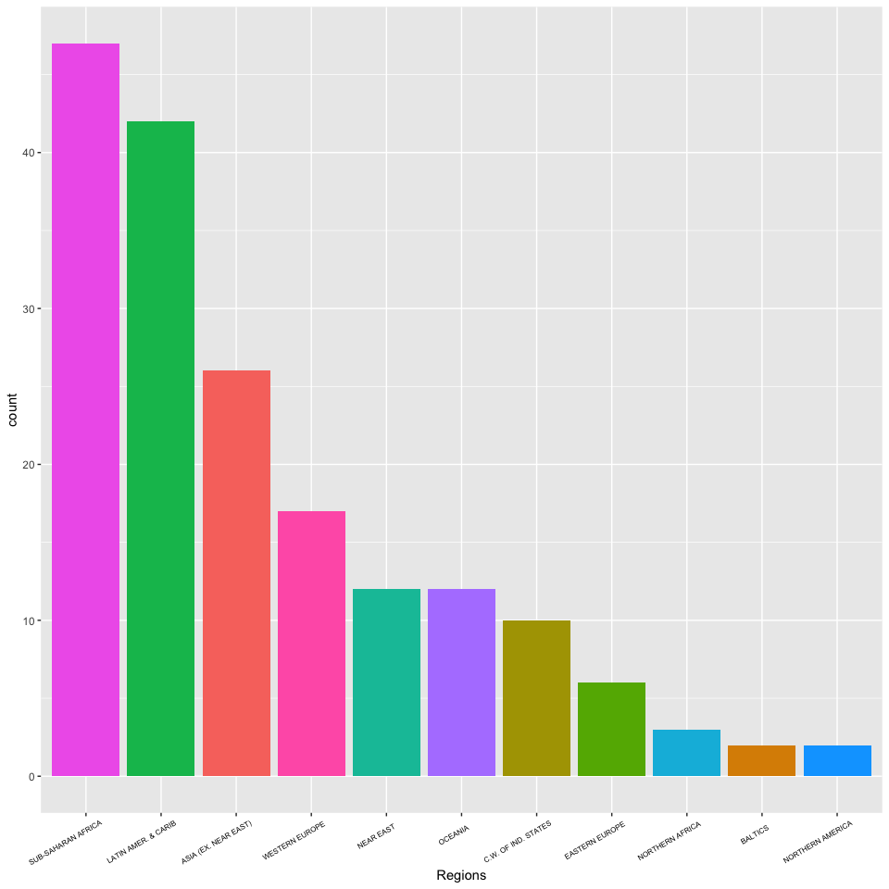
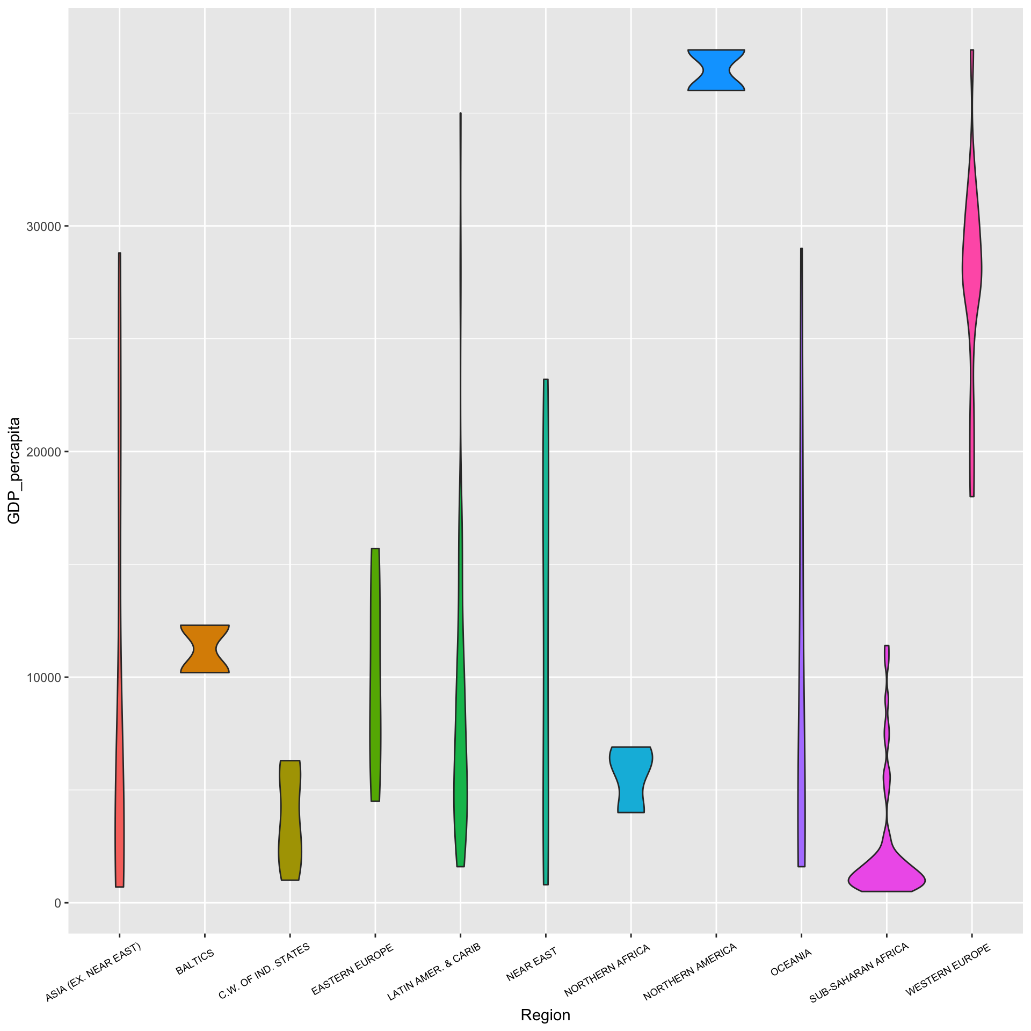
Count of Countries by Region
GDP Per Capita by Region

Slide 8
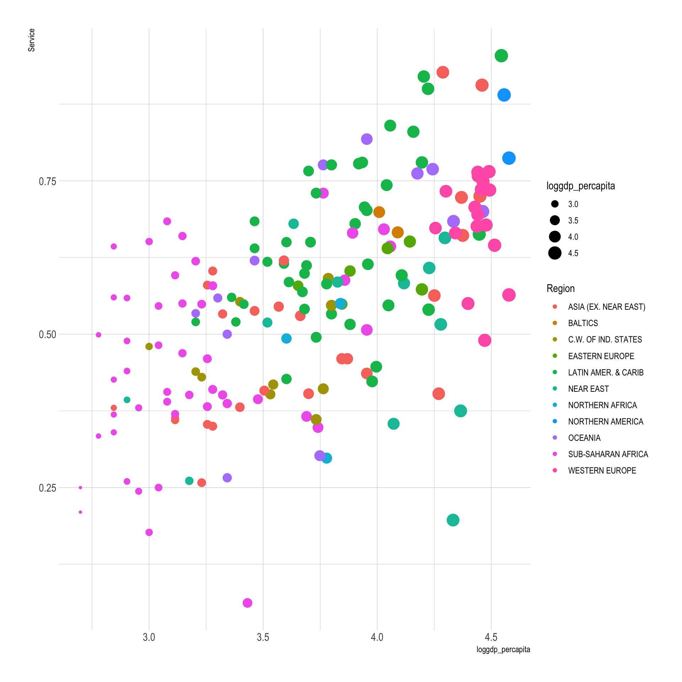
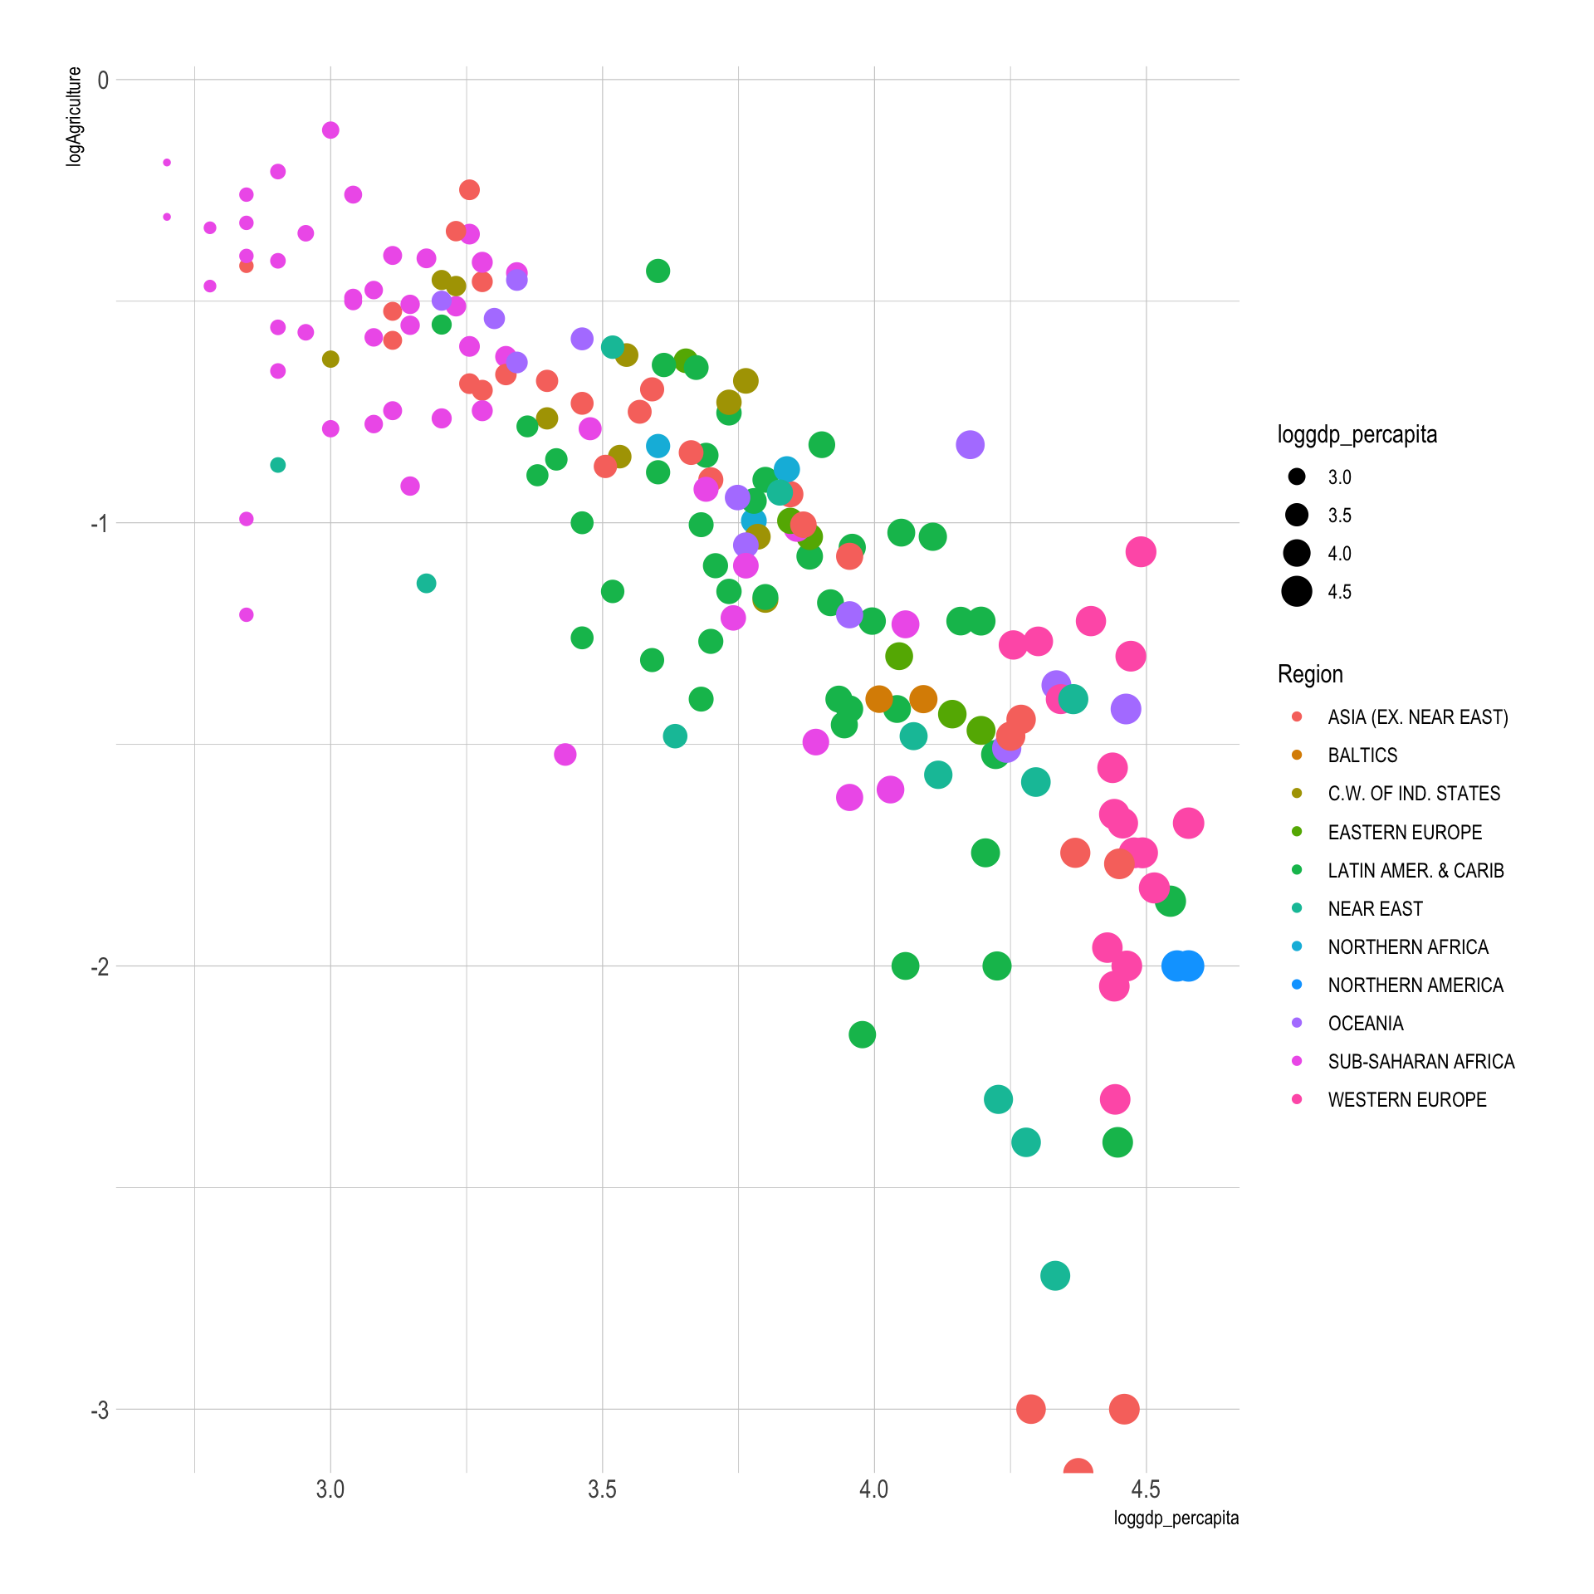
LogAgriculture Economies vs. logGDP Per Capita by Region
Service Economies vs. logGDP Per Capita by Region

Slide 9
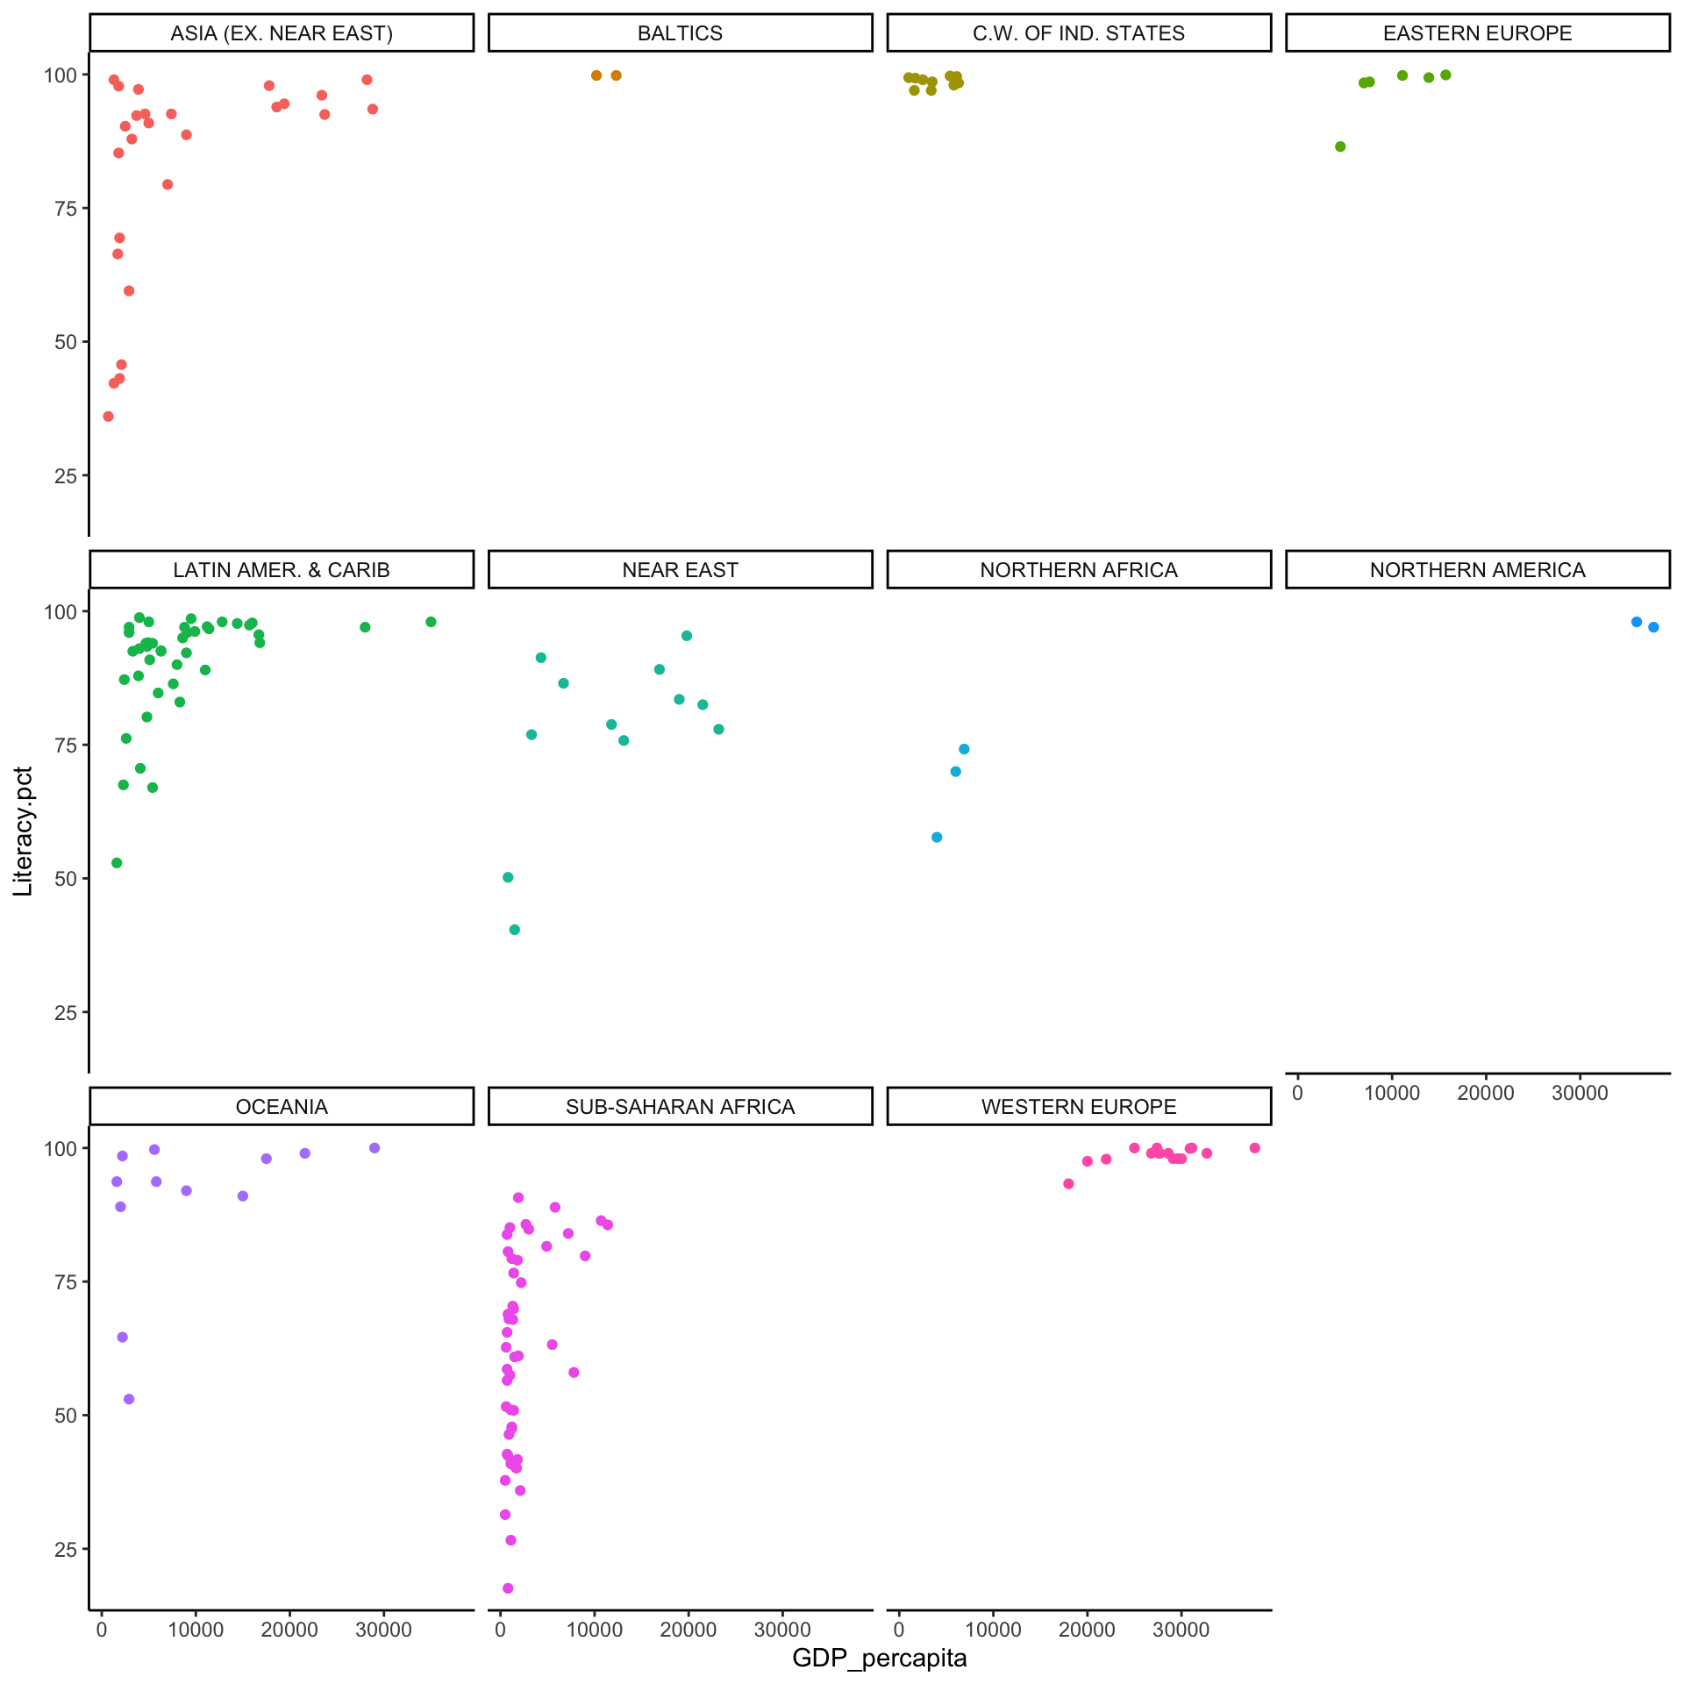
Literacy pct. vs. logGDP Per Capita by Region

Slide 10
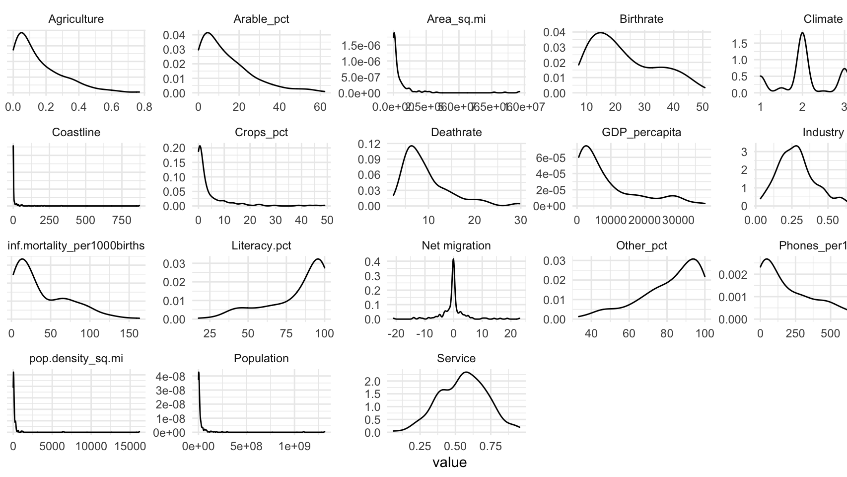
Distribution of Variables

Slide 11
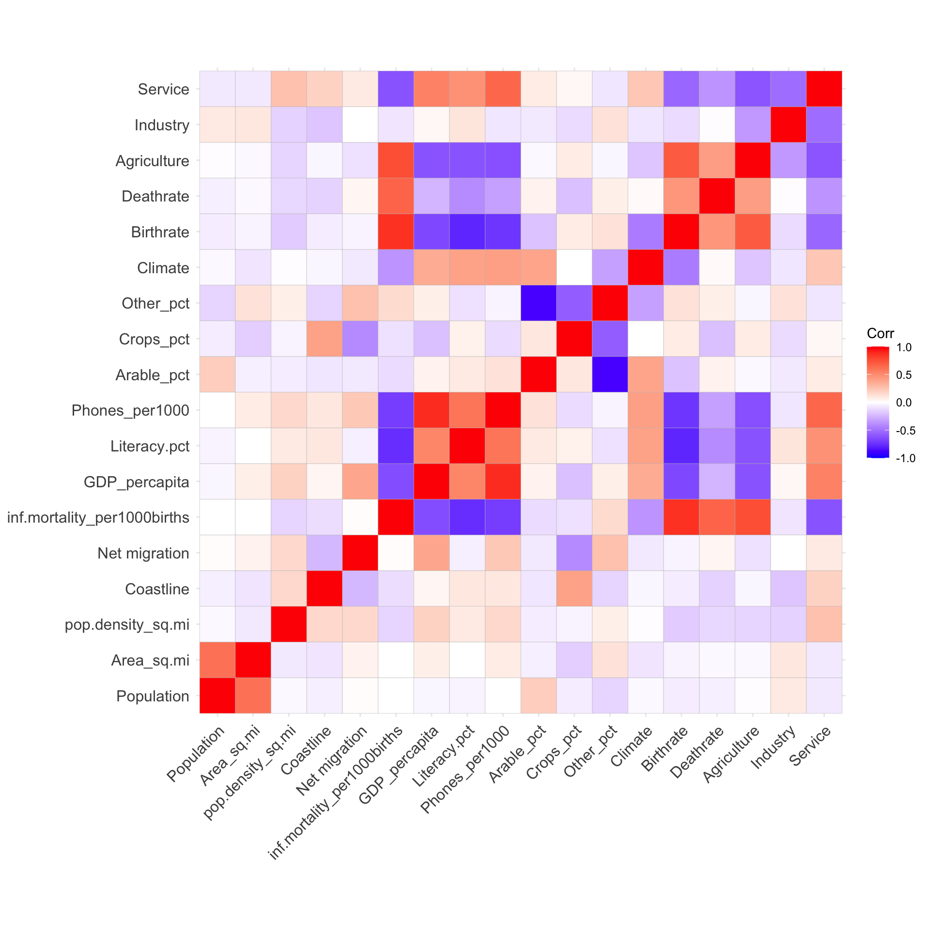
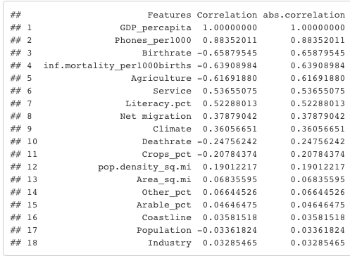
Correlation of Independent Variables w/ GDP Per Capita
Correlation of Independent Variables w/ GDP Per Capita

Slide 12

Model Selection

Slide 13
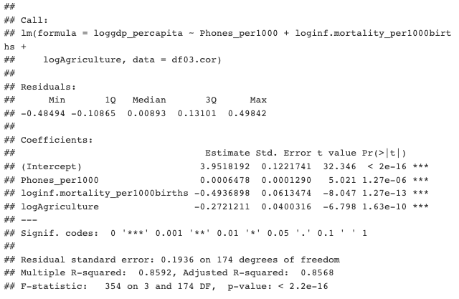
Simple Model
To create the simple model, first we introduced the variable with the highest correlation to Log GDP Per Capita into our regression
Loginf.mortality_per1000births
Checked the residuals of the model against the remaining variables to see if the residuals of the model can be explained by any of our variables.
LogAgriculture had a relationship with the first model
Phones_per1000 had relationship with the second model
The remaining variables looked random so we can stop the simple model here

Slide 14
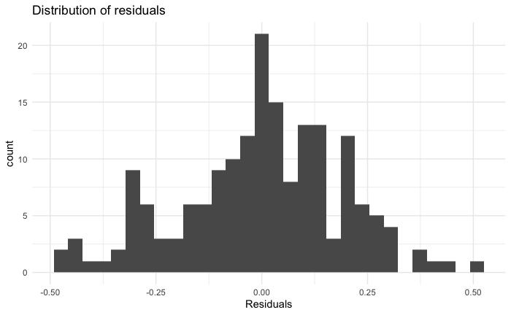
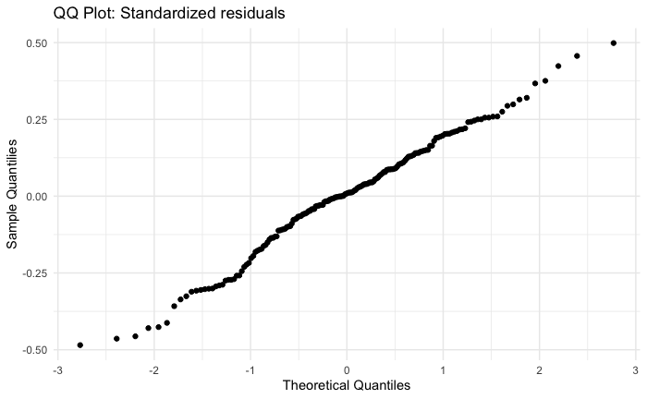
Simple Model – Residual Plots
QQ plot looks linear
The residual histogram also looks normally distributed. We don’t believe this model violates any model assumptions

Slide 15
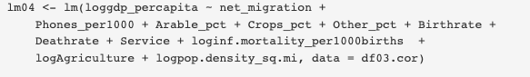
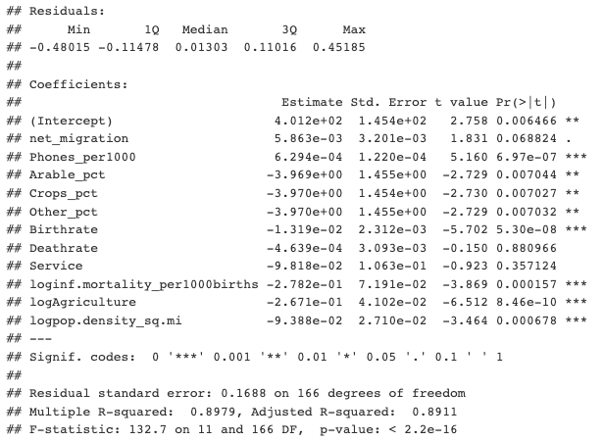
Kitchen Sink Model
For the kitchen-sink model, the team placed all the variables into a regression and used a backward model selection method
Used AIC to find the final model
AIC determines which model is the best model for our dataset
AIC = - 2*log L + k * edf
Final model with the lowest AIC score had 12 variables
AIC score: -621.7977
Conducted 5-k cross fold validation on kitchen-sink model
Splits data into 5 equal parts, with 4 training parts and 1 testing part in each
Mean RMSE of all 5 data partition is 0.1765826

Slide 16
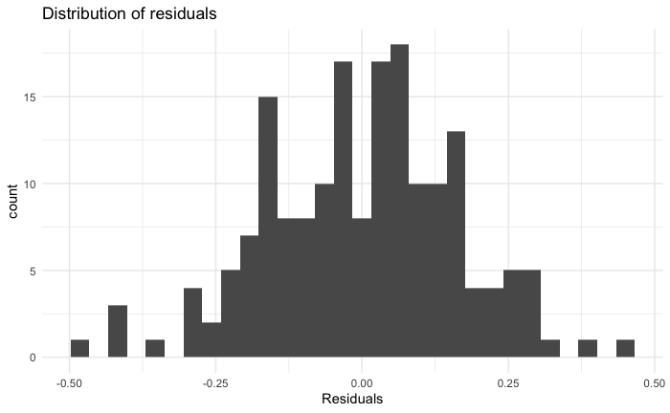
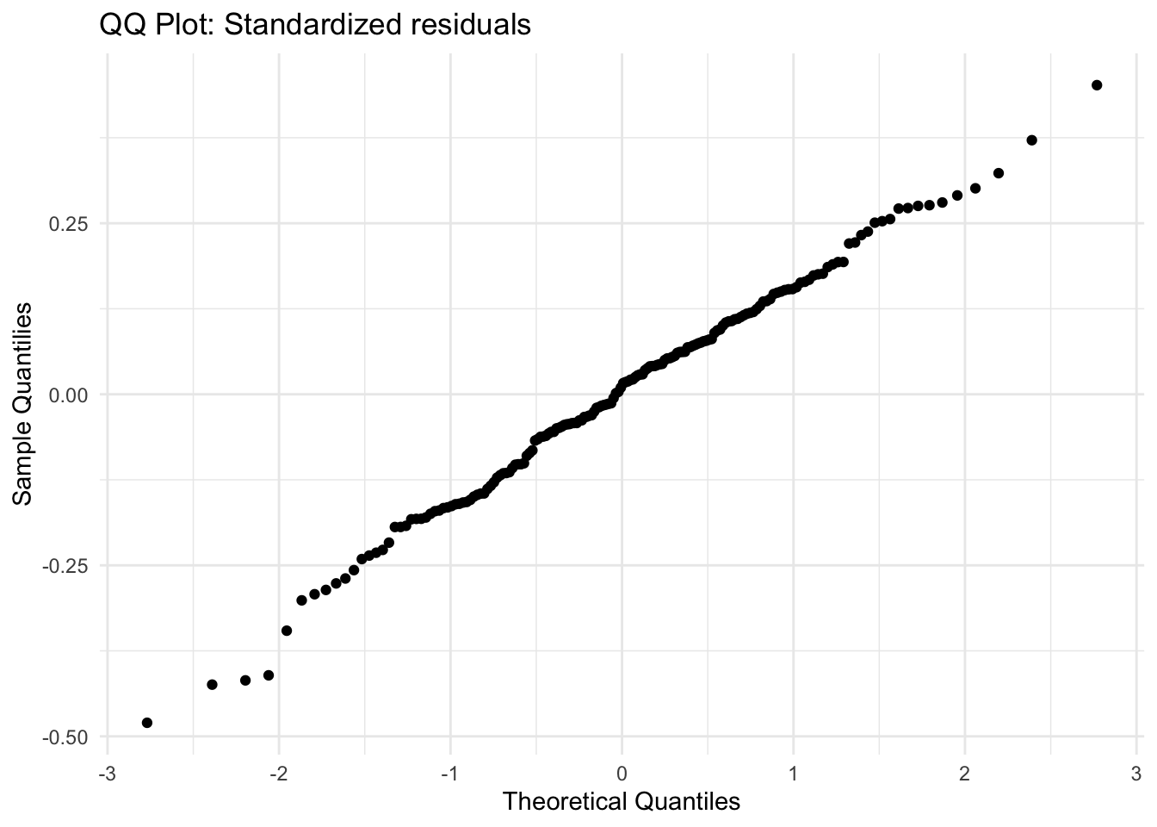
Kitchen Sink Model – Residual Plots
QQ plot looks linear
The residual histogram also looks normally distributed. We don’t believe this model violates any model assumptions

Slide 17
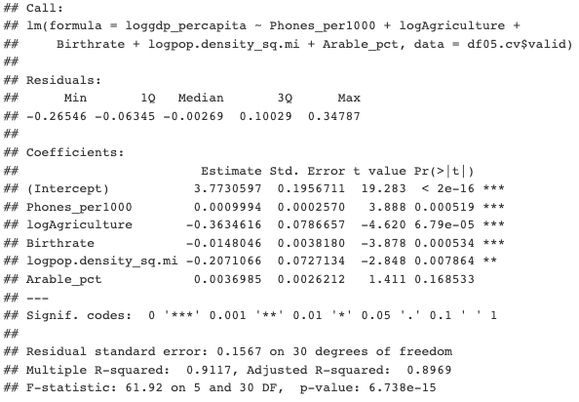
Forward Stepwise Model
Performed a greedy forward stepwise selection on 17 variables
Model starts with a null set and adds the best predictor variables until RMSE stops improving
5 variables were chosen the rest were dropped
RMSE on validation set 0.1430894
RMSE on test set 0.215647

Slide 18
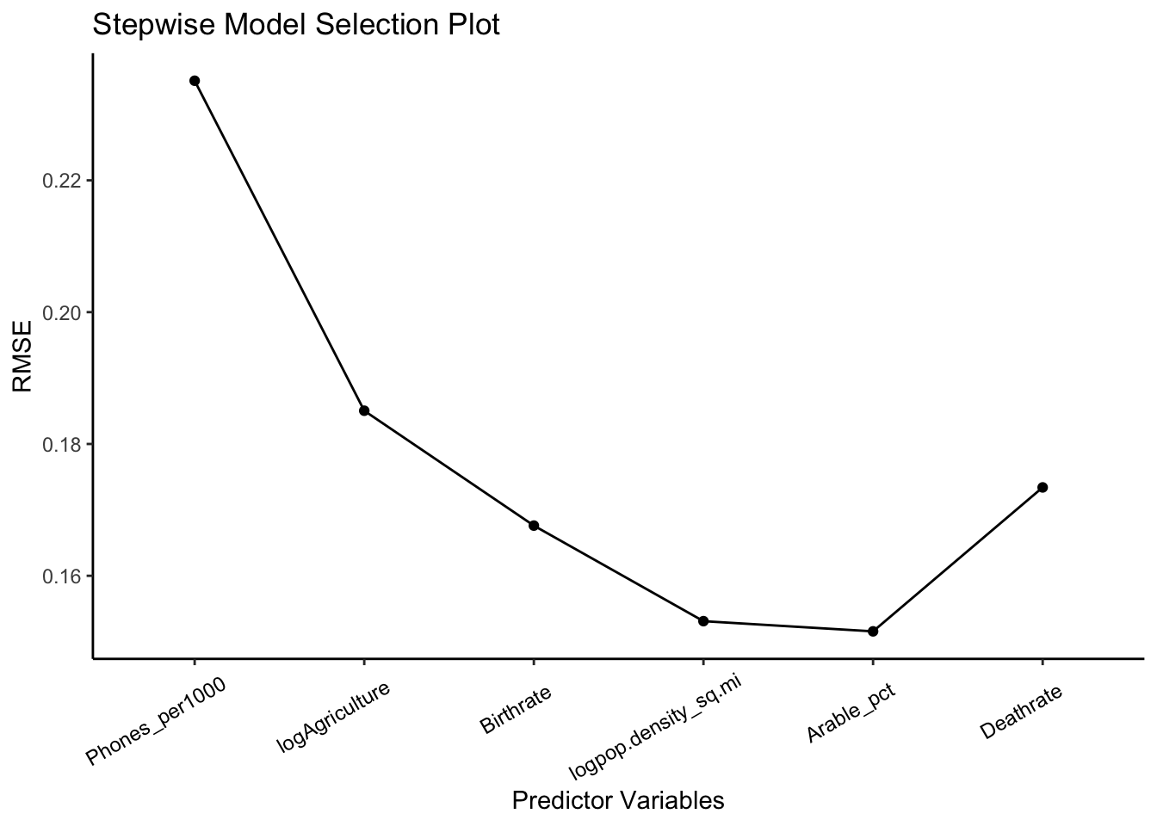

Slide 19
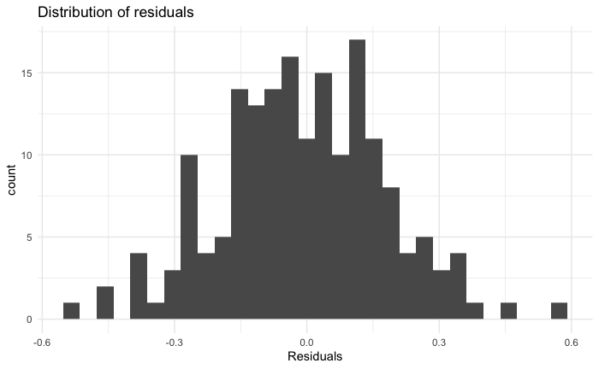
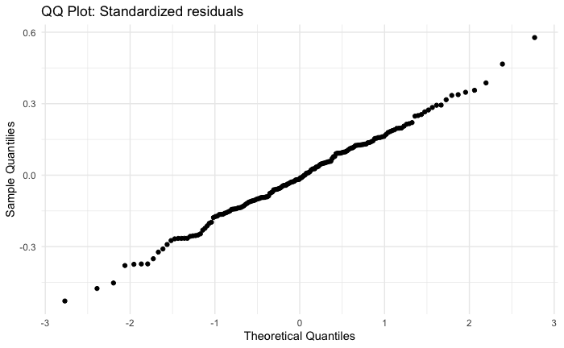
Forward Stepwise Model – Residual Plots
QQ plot looks linear
The residual histogram also looks normally distributed. We don’t believe this model violates any model assumptions

Slide 20
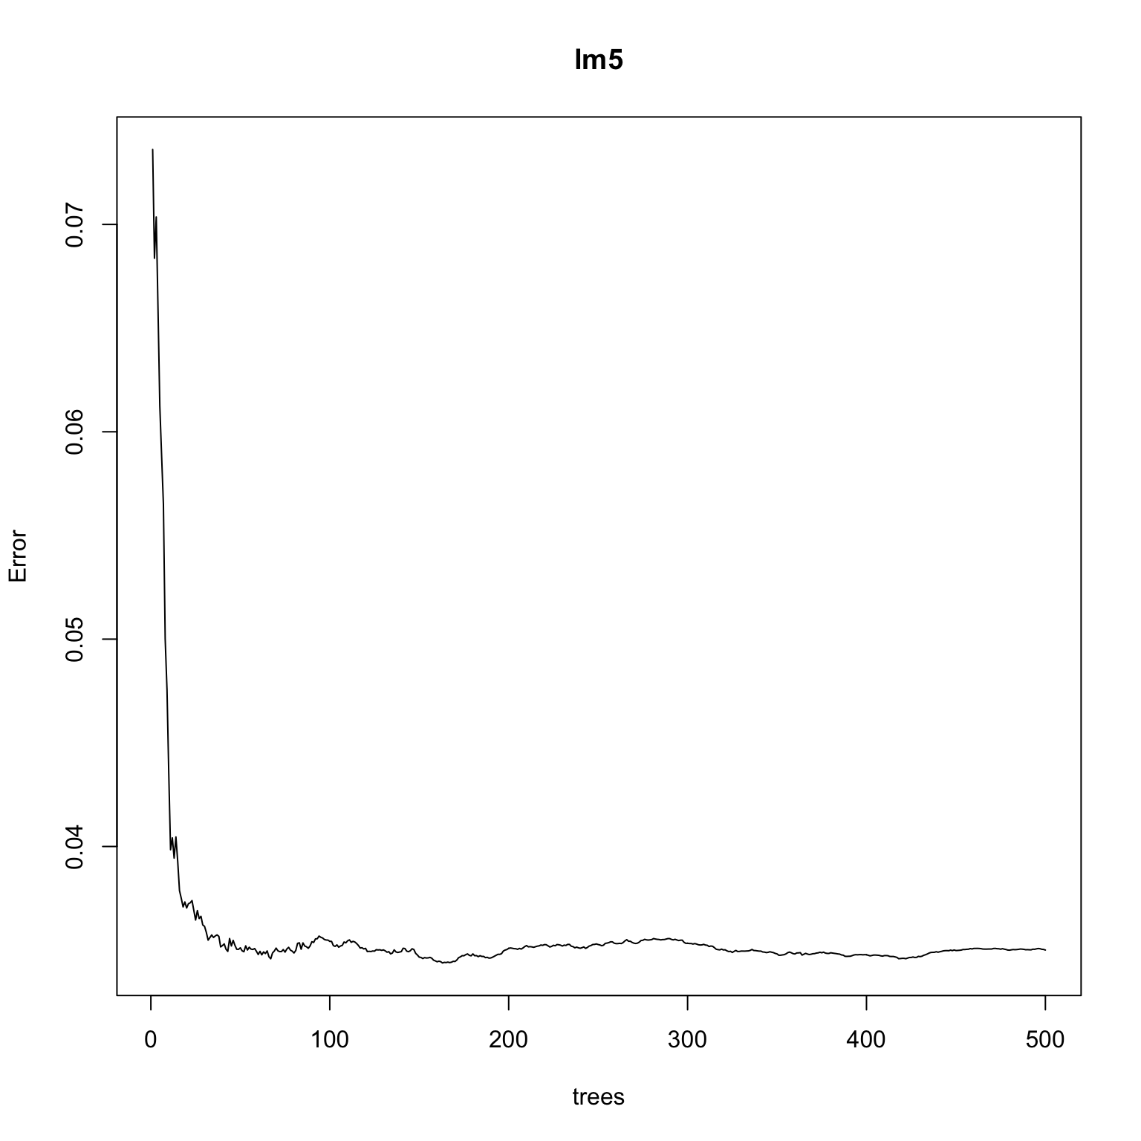
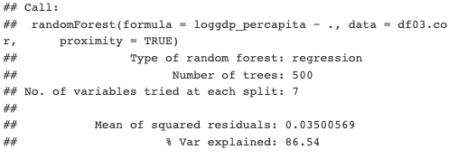
Random Forest Model
Preformed a greedy random forest with all the variables
500 decision trees and new data frame
RMSE on validation set 0.084405
RMSE on test set 0.06962556
Very strong model!

Slide 21
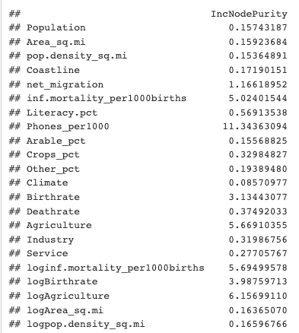
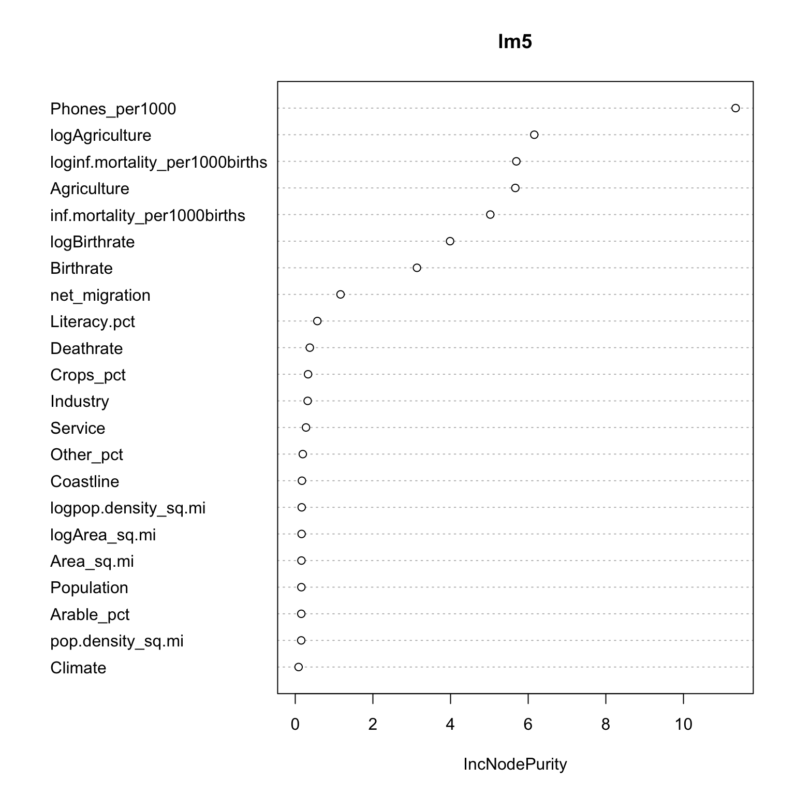
Random Forest Model
Best participating variables into Purity graph

Slide 22
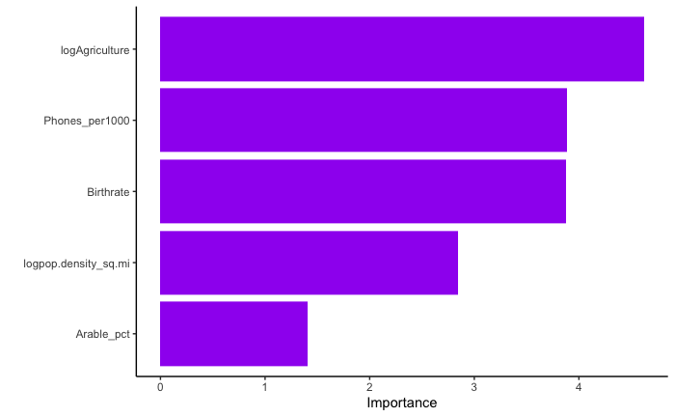
Final Model Conclusion
Although the rf was a better model, due to its interpretability and simpleness, we’ve decided to choose the forward stepwise model as our best model for this project
Positive predictor variables GDP Per Capita:
Phones_per1000
Arable_pct
Negative predictor variables GDP Per Capita:
logAgriculture
logpop.density_sq.mi
Birthrate

Slide 23
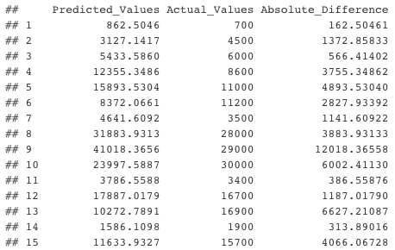
Final Model Conclusion
Prediction of GDP Per Capita
Stepwise model predictions of GDP Per Capita
Absolute Difference Mean: $3,094.235

Slide 24
Discussion
Who Could Benefit:
Possible Improvements:
Economic Students interested in Economic Development
Policymakers
NGOs
Private Sectors Interested in FDI
More domain expertise
Understanding the problem as an expert could lead to a different model
Random forest regression tunning
Hyperparameter tuning
GDP Per Capita shouldn’t be the only measurement of economic growth, expanding analysis for other indicators such as mental health or sustainability would add improve our understanding of which countries that are executing well
Limitations:
Model only had 227 data points
More datapoints with different time periods would improve model prediction
Strong correlation does NOT imply a cause-and-effect relationship
Real-time dataset for Dynamic analysis
Regional or National gaps in data reports.
The number of variables are limited. More variables to test against GDP Per Capita the better

Slide 25

THANK YOU

Slide 26
Work Citation
https://www.kaggle.com/bbhatt001/measures-of-economic-development/data

Slide 27
Appendix
The entire codebook for this project is published Here:
https://rpubs.com/Kalide/847851

